Slide 1


Cloud native apps
Marc Bruins (Xpirit)
mbruins@xpirit.com

Slide 2
Agenda
09:00 – 09:15 Introduction
09:15 – 10:00 Presentation, sharing information
10:00 – 13:00 Design whitepaper session
13:00 – 13:30 break
13:30 – 17:00 Hands on labs

Slide 3
Introduction
Please do a quick introduction of yourself and what you are hoping to get out of this day.
I’ll start.

Slide 4
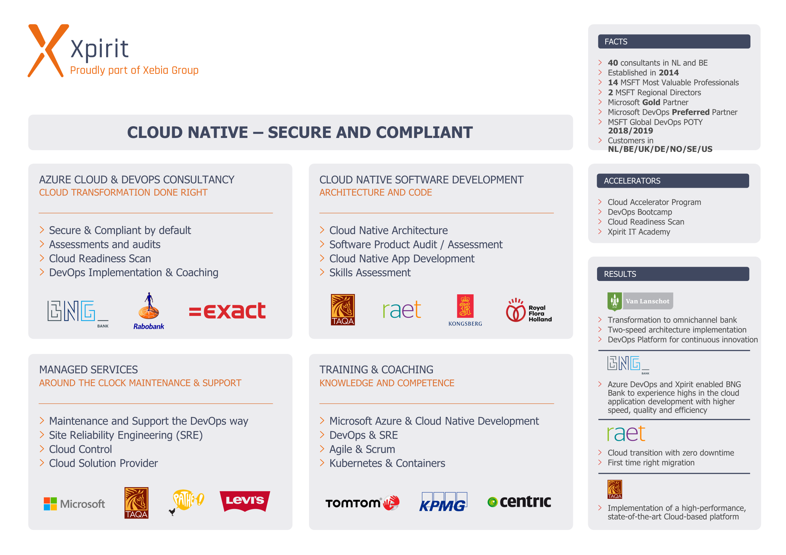
Hiring!

Slide 5
Cloud native another buzzword?
Lets look at some definitions:
Cloud native is all about changing the way you think about constructing critical business systems.
Cloud-native systems are designed to embrace rapid change, large scale, and resilience.
What do you think cloud native means?
The official definition from the Cloud Native Computing Foundation
Cloud-native technologies empower organizations to build and run scalable applications in modern, dynamic environments such as public, private, and hybrid clouds. Containers, service meshes, microservices, immutable infrastructure, and declarative APIs exemplify this approach.
These techniques enable loosely coupled systems that are resilient, manageable, and observable. Combined with robust automation, they allow engineers to make high-impact changes frequently and predictably with minimal toil.
My definition: Cloud native is about speed and agility by leveraging cloud services.

Slide 6
So which companies used it?
Company | Experience
Netflix | Has 600+ services in production. Deploys hundred times per day.
Uber | Has 1,000+ services in production. Deploys several thousand times each week.
WeChat | Has 3,000+ services in production. Deploys 1,000 times a day.

Slide 7
So is cloud native == microservices?
Not necessarily, cloud native is leveraging cloud for speed and agility.
Microservices can be seen as autonomous business capability when setup correctly.
Can a monolith get speed and agility?
Yes definitely, especially a well structured monolith
It can be hard though
Can microservices get speed and agility
Again yes, these are the major benefits for Microservices
But be carefull not to shoot yourself in the foot!

Slide 8
A monolith, the good and the bad
The good | The bad
Easy to build | Too complicated – changes are scary
Easy to deploy | New features/fixes become tricky, time-consuming, and expensive to implement.
Easy to test | It's difficult to implement agile delivery methodologies.
Easy to troubleshoot | Small changes requires a full new deployment
Easy to scale as a whole | Consultants tell you to rewrite it

Slide 9
Migrating to Microservices be more cloud native?
Is it a must to migrate to Microservices to leverage cloud native benefits?
No, however it could be
There is also a in between option
Where will you benefit from a “autonomous business capability”?
A migration from a monolith to microservices should have business benefits in the end. It’s fine to have a part monolith and a part microservices
Tip: for shifting workloads to the cloud look at the 6R model
For architecting microservices look at Domain Driven Design.

Slide 10
Let’s build!
Another day, at the office, working on "the next big thing."
Your cellphone rings. It's your friendly recruiter - the one who calls you twice a day about new jobs.
But this time it's different: Start-up, equity, and plenty of funding.
The mention of the cloud and cutting-edge technology pushes you over the edge.
Fast forward a few weeks and you're now a new employee in a design session architecting a major eCommerce application. You're going to compete with the leading eCommerce sites.
How will you build it?

Slide 11
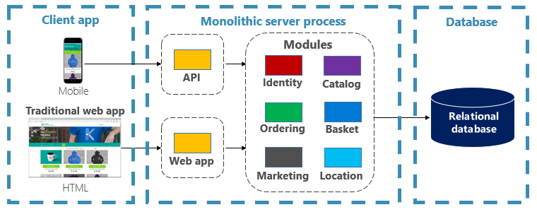
A monolithic approach – application level

Slide 12
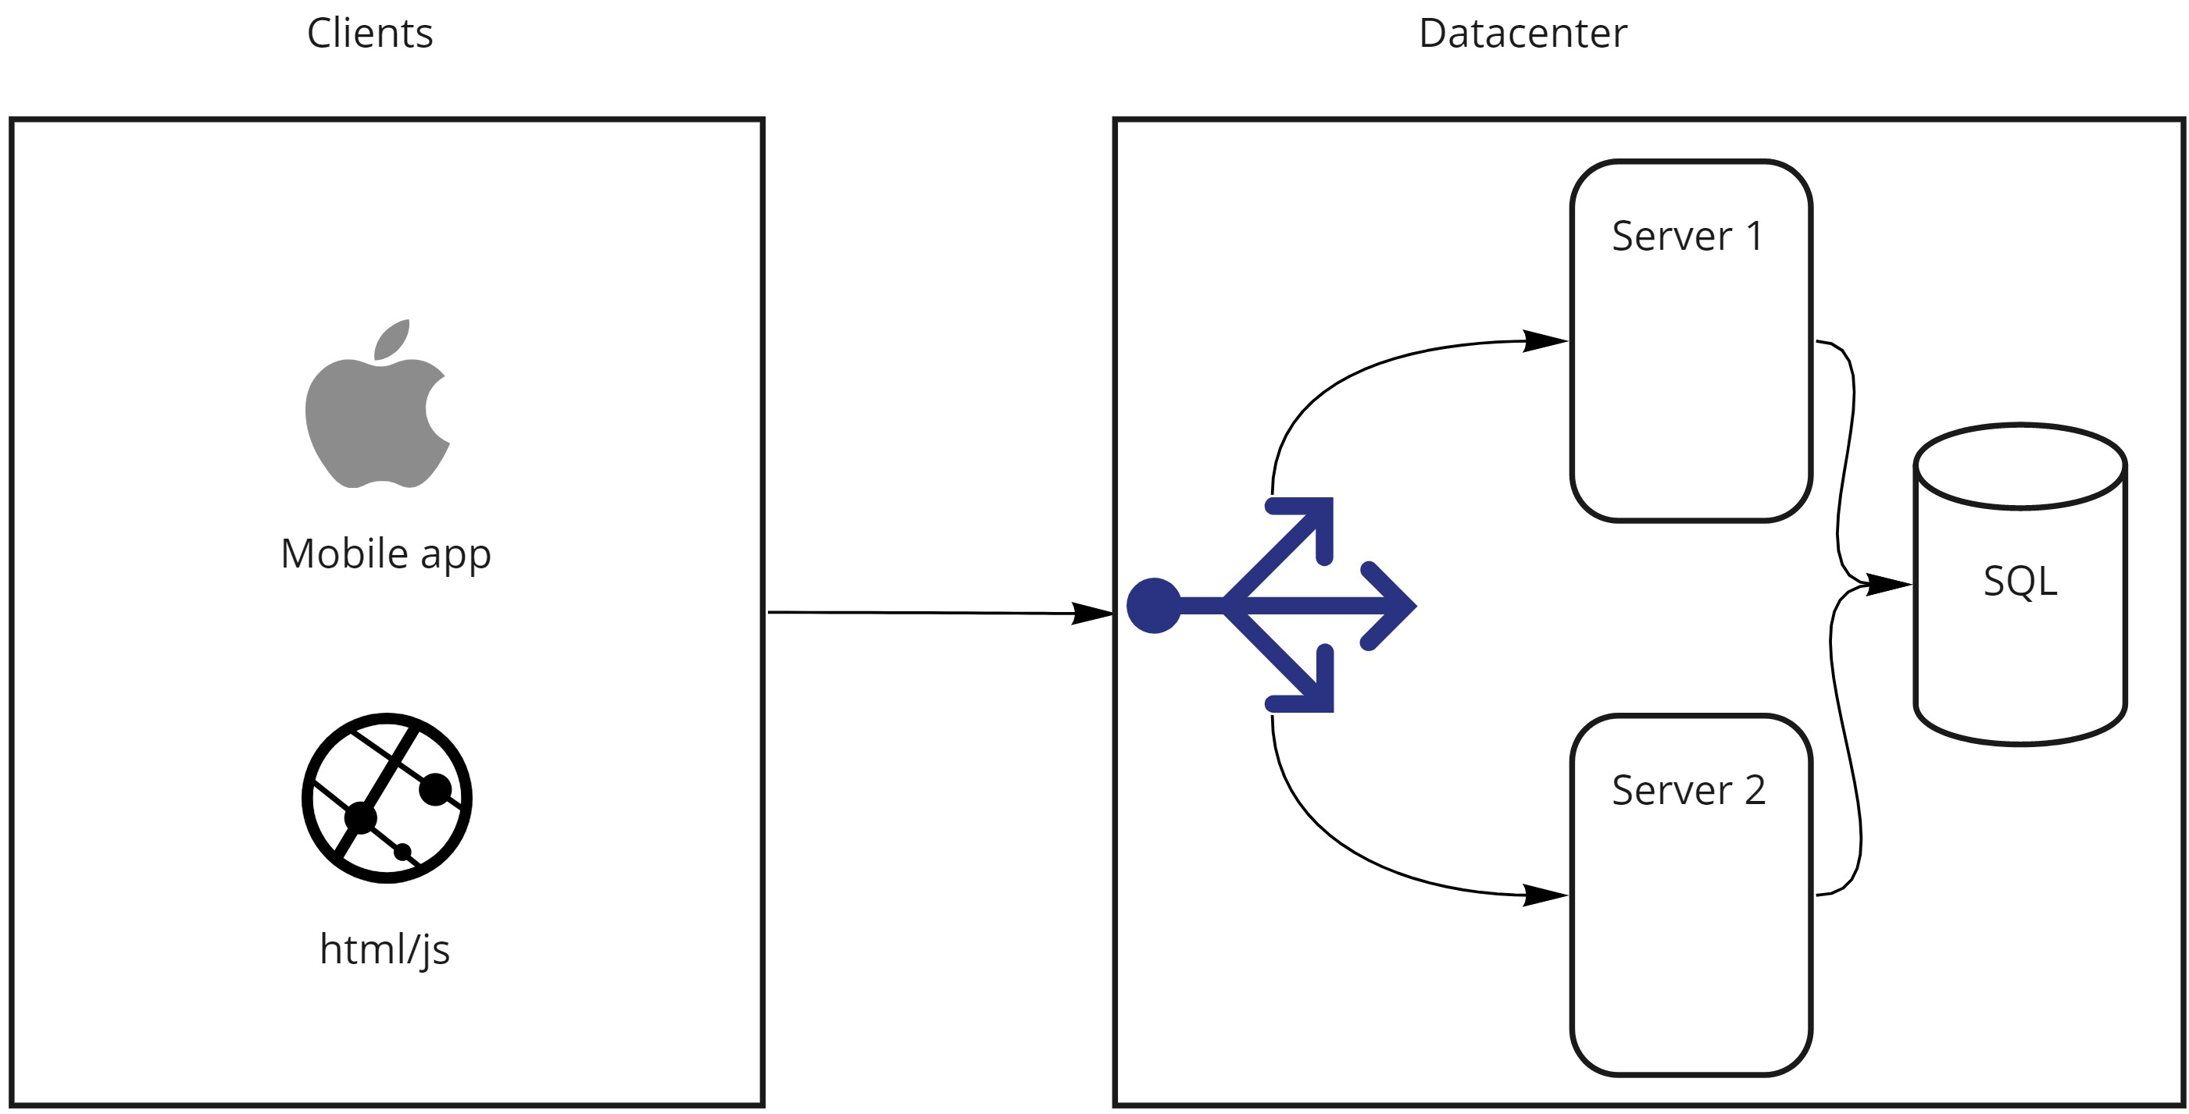
A monolithic approach – infra level

Slide 13
Wow we got acquired by facebook!
Great news! Our CEO just got out of a meeting with facebook and we got acquired!
Every Facebook user will be using our online ecommerce system to do it’s shopping. We need to expand and make sure our systems are reliable!
Can you setup the following things:
Autoscale the ordering process, we know it’s slow
Our catalogue will also explode, can we scale that and make that extra resilient? Maybe deploy it to other regions of the world to optimize loading times?
How do we onboard new engineers? The codebase is becoming immense and hard to read!
We need to be agile and fast, how can we deploy a few times a day?
Will our monolith do?
Let’s re-architect!

Slide 14
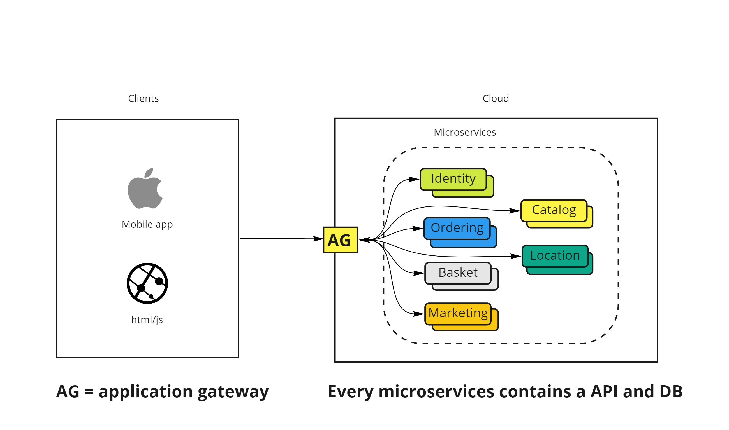
A cloud native approach – application level

Slide 15
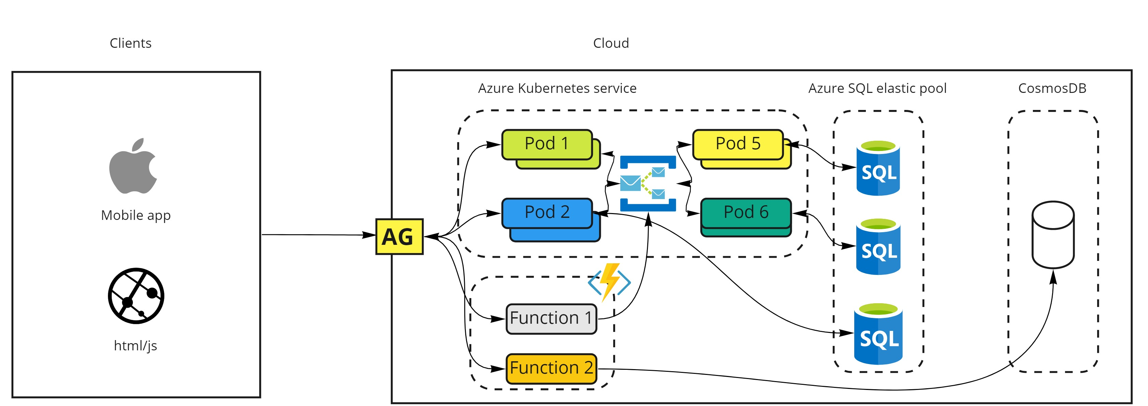
A cloud native approach – infra level

Slide 16
After re-architecting
Our realised benefits
Faster Release.
Ease of Management.
Reduced Cost.
Reliable System.
Scalability.
Easy to understand and learn
In the end we can accelerate our business because we achieve speed & agility.

Slide 17
Azure Cloud native services
Why are cloud native services so important to realize these gains?
Can we pinpoint some cloud native services inside Azure?

Slide 18
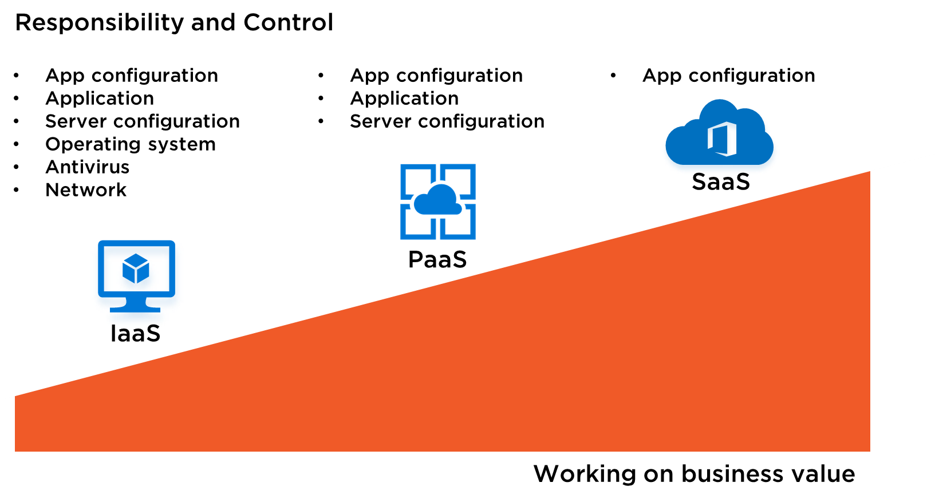
What would be a candidate for cloud native?
Our realised benefits
Faster Release.
Ease of Management.
Reduced Cost.
Reliable System.
Scalability.
Easy to understand and learn
In the end we can accelerate our business because we achieve speed & agility.

Slide 19
What would be a candidate for cloud native?
Our realised benefits
Faster Release.
Ease of Management.
Reduced Cost.
Reliable System.
Scalability.
Easy to understand and learn
In the end we can accelerate our business because we achieve speed & agility.

Slide 20
Azure Kubernetes service sidenote
There is a lot of discussion if Azure Kubernetes service is PaaS or IaaS.
Yes there is a managed component from the Azure side(the master node) however there is still a lot of thing to do.
Write YML for configuration
Setup ingress controller
Secure the pods with RBAC(default it’s unsecure)
Setup certificates for communication
Service discovery
Trust between services and to azure(keyvault for example)
A service mesh take a part of this away
https://istio.io/latest/
We manage this professionally for customers (managed kubernetes page?)

Slide 21
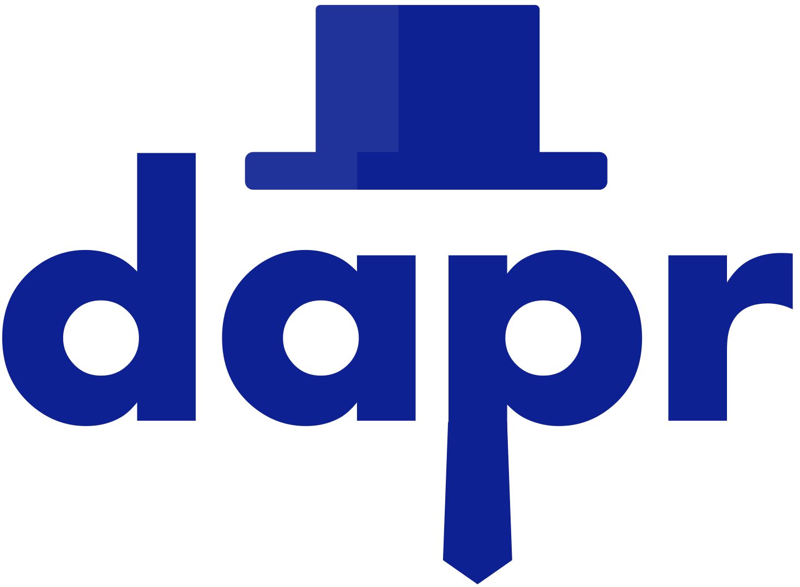
A look inside the crystal ball
Expect a evolution fromKubernetes platform
From a application perspective it’s already there!
Meet DAPR: https://dapr.io/
Let’s watch: https://youtu.be/9o9iDAgYBA8
What are we still missing in my opinion
An application deployment model with an intelligent control plane. Using this model we can describe our overall application with a cloud native Azure service experience, covering not just compute resources, but the other associated resources for your application, for example storage, messaging (pub/sub), etc.
By default trusted to one and other with managed identity(no more service principals and password!)

Slide 22
Questions?
Any questions or remarks before we move to the next part?

Slide 23
Whiteboard design session
Step 1: Review the customer case study (15 minutes)
Step 2: Design a proof of concept solution (60 minutes)
Step 3: Present the solution to each other (30 minutes)
Step 4: Additional questions answering (30 minutes)

Slide 24
Whiteboard design session
Decide on how to share your solution.
https://miro.com/app/board/o9J_lFFmD6k=/

Slide 25
Whiteboard design session
Propose the solution to the customer
Team 1 pairs with team 2
Team 3 pairs with team 4
Team 5 pairs with team 6
etc

Slide 26
Whiteboard design session
https://github.com/microsoft/Cloud-Native-In-a-Day/

